Slide 1

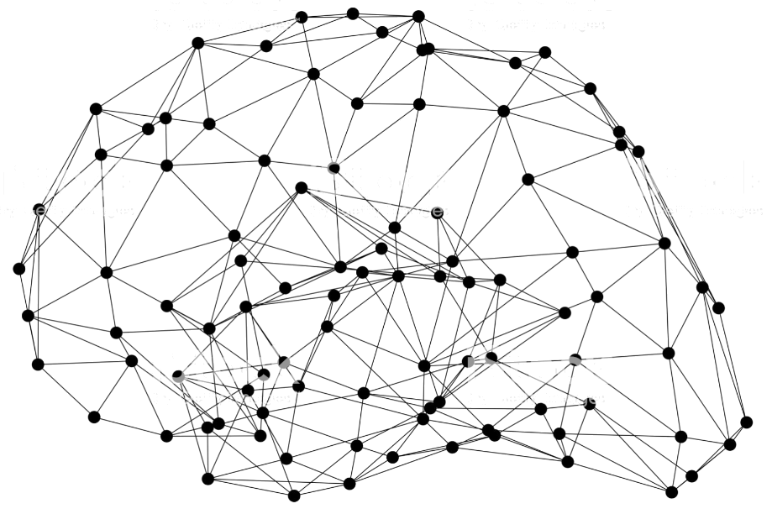

Amazon SageMaker
Understanding Built-in Algorithms
Immersion Day
Notes:
Amazon SageMaker is a fully managed service that allows developers and data scientists can use to build, train, and deploy machine learning models. There are a lot of components to SageMaker, whether you’re using the manged development environments, the ephemeral training clusters, the hyperparamter tuning, or the deployed endpoint

Slide 2
The AWS ML stack Broadest and most complete set of machine learning capabilities
Vision
Chatbots
Business tools
Search
Healthcare
Rekognition
Lex
Personalize Forecast Fraud Detector
Lookout for Metrics
Kendra
HealthLake
Comprehend Medical
Transcribe Medical
AI SERVICES
Speech
Text
Contact centers
Code + DevOps
Industrial
Polly Transcribe
Comprehend Translate Textract
Contact Lens Connect Voice ID
CodeGuru DevOps Guru
Panorama Appliance and SDK, Monitron, Lookout for Equipment, Lookout for Vision
SAGEMAKER STUDIO IDE
Label data
Data collection prep
Store features
Detect bias and explain predictions
Visualize in notebooks
Pick algorithm
Train models faster
Tune parameters
Deploy in production
Manage & monitor
Manage edge devices
AMAZON SAGEMAKER
CI/CD
ML FRAMEWORKS & INFRASTRUCTURE
TensorFlow, PyTorch, Apache MXNet
Deep learning AMIs & containers
GPUs
Inferentia
Elastic inference
FPGA
Notes:
We’re innovating on behalf of our customers to deliver the broadest and deepest set of machine learning capabilities for builders of all levels of expertise. At each layer of the stack, we’re investing in removing the undifferentiated heavy lifting so your teams can move faster.
At the top layer are our AI Services, which allow developers to easily add intelligence to any application without needing ML skills. The pre-trained models provide ready-made intelligence for your applications and workflows to help you do things like personalize the customer experience, forecast business metrics, translate conversations, extract meaning from documents and more.
At the middle layer is Amazon SageMaker, which provides every developer and data scientist with the ability to build, train, and deploy machine learning models at scale. It removes the complexity from each step of the machine learning workflow so you can more easily deploy your machine learning use cases, anything from predictive maintenance to computer vision to predicting customer behaviors. Customers can achieve up to 10 times improvement in data scientists’ productivity with Amazon SageMaker.
And at the bottom layer, expert practitioners can develop on the framework of their choice as a managed experience in Amazon SageMaker or use the AWS Deep Learning AMIs (Amazon machine images), which are fully configured with the latest versions of the most popular deep learning frameworks and tools.

Slide 3
In this section - Build
Amazon SageMaker
PREPARE
SageMaker Ground Truth Label training data for machine learning
SageMaker Data Wrangler NEW Aggregate and prepare data for machine learning
SageMaker Processing Built-in Python, BYO R/Spark
SageMaker Feature Store NEW Store, update, retrieve, and share features
SageMaker Clarify NEW Detect bias and understand model predictions
BUILD
SageMaker Studio Notebooks Jupyter notebooks with elastic compute and sharing
Built-in and Bring your-own Algorithms Dozens of optimized algorithms or bring your own
Local Mode Test and prototype on your local machine
SageMaker Autopilot Automatically create machine learning models with full visibility
SageMaker JumpStart NEW Pre-built solutions for common use cases
TRAIN & TUNE
Managed Training Distributed infrastructure management
SageMaker Experiments Capture, organize, and compare every step
Automatic Model Tuning Hyperparameter optimization
Distributed Training NEW Training for large datasets and models
SageMaker Debugger NEW Debug and profile training runs
Managed Spot Training Reduce training cost by 90%
DEPLOY & MANAGE
Managed Deployment Fully managed, ultra low latency, high throughput
Kubernetes & Kubeflow Integration Simplify Kubernetes-based machine learning
Multi-Model Endpoints Reduce cost by hosting multiple models per instance
SageMaker Model Monitor Maintain accuracy of deployed models
SageMaker Edge Manager NEW Manage and monitor models on edge devices
SageMaker Pipelines NEW Workflow orchestration and automation
SageMaker Studio Integrated development environment (IDE) for ML
Notes:
As I mentioned previously, SageMaker is a service with a lot of different features and capabilities in it. We typically talk about those capabilities as falling into four categories: Data preparation, the model build phase, training and tuning, and deployment and management (or hosting).
These four categories really address the needs that ML builders have when dealing with each stage of a model’s lifecycle.
Later in this presentation I can give you a full feature tour of as many of these features might be interesting to you.
===== Interaction Opportunity =====
I’ll pause here for a moment to see if there are any capabilities that you see listed here which may be of particular interest to you and your organization at this point in time?
Great – well we can certainly dive deeper into that in just a few moments.

Slide 4









Model Options
AWS Marketplace for
Machine Learning
Amazon SageMaker AutoPilot
Training code
XGBoost - Gradient Boosted Trees
Matrix Factorization
Regression
Principal Component Analysis
K-Means Clustering
And More!
Built-in Algorithms (17)
No ML coding required
Bring Your Own Script
Amazon SageMaker builds the container
Open source containers
Bring Your Own Container
Full control, you build the container
R, C++, etc
Fully Managed, Distributed, Auto-Scaled, Secured
Notes:
Once the data is in S3, I need to choose an algorithm to train my model

Slide 5
Amazon SageMaker Built-in Algorithms
Computer vision
Image classification | Object detection | Semantic segmentation
Topic modeling
LDA | NTM
Classification
Linear Learner | XGBoost | KNN
Recommendation
Factorization machines
Forecasting
DeepAR
Working with text
BlazingText | Supervised | Unsupervised
Regression
Linear Learner | XGBoost | KNN
Clustering
Kmeans
Sequence translation
Seq2Seq
Anomaly detection
Random cut forests | IP Insights
Feature reduction
PCA
Notes:
Amazon SageMaker comes with dozens of pre-build algorithms. Amazon SageMaker provides high-performance, scalable machine learning algorithms, optimized for speed, scale, and accuracy, that can perform training on petabyte-scale data sets. You can choose from supervised algorithms where the correct answers are known during training and you can instruct the model where it made mistakes. Amazon SageMaker includes supervised algorithms such as XGBoost and linear/logistic regression or classification, to address recommendation and time series prediction problems. Amazon SageMaker also includes support for unsupervised learning (i.e. the algorithms must discover the correct answers on their own), such as with k-means clustering and principal component analysis (PCA), to solve problems like identifying customer groupings based on purchasing behavior.
Built in algos: BlazingText Algorithm – Text classification, NLP tasks such as (NLP) tasks, such as sentiment analysis, named entity recognition.
DeepAR Forecasting Algorithm - supervised learning algorithm for forecasting scalar time series using RNN
Factorization Machines Algorithm - can be used for both classification and regression tasks on high dimensional sparse datasets
Image Classification Algorithm - uses a CNN (ResNet) that can be trained from scratch, or trained using transfer learning
IP Insights Algorithm - unsupervised learning algorithm that learns the usage patterns for IPv4 addresses
K-Means Algorithm - attempts to find discrete groupings within data
K-Nearest Neighbors (k-NN) Algorithm - uses a non-parametric method for classification or regression
Latent Dirichlet Allocation (LDA) Algorithm - attempts to describe a set of observations as a mixture of distinct categories
Linear Learner Algorithm - unsupervised learning algorithms used for solving either classification or regression problems
Neural Topic Model (NTM) Algorithm - organizes a corpus of documents into topics
Object2Vec Algorithm - general-purpose neural embedding algorithm that is highly customizable
Object Detection Algorithm - detects and classifies objects in images using a single deep neural network (SSD), VGG or ResNet
Principal Component Analysis (PCA) Algorithm - algorithm that attempts to reduce the dimensionality
Random Cut Forest (RCF) Algorithm - unsupervised algorithm for detecting anomalous data points within a data set
Semantic Segmentation Algorithm - provides a fine-grained, pixel-level approach to developing computer vision applications
Sequence-to-Sequence Algorithm - input is a sequence (for example, text, audio) and the output is another sequence
XGBoost Algorithm - popular and efficient open-source implementation of the gradient boosted trees algorithm

Slide 6
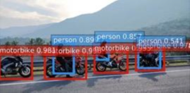

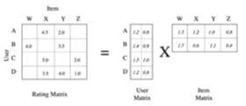
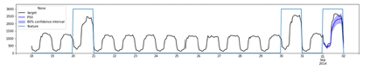
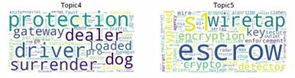
Amazon SageMaker built-in algorithms
Object detection
Semantic segmentation
Factorization Machines
DeepAR
Neural topic model

Slide 7
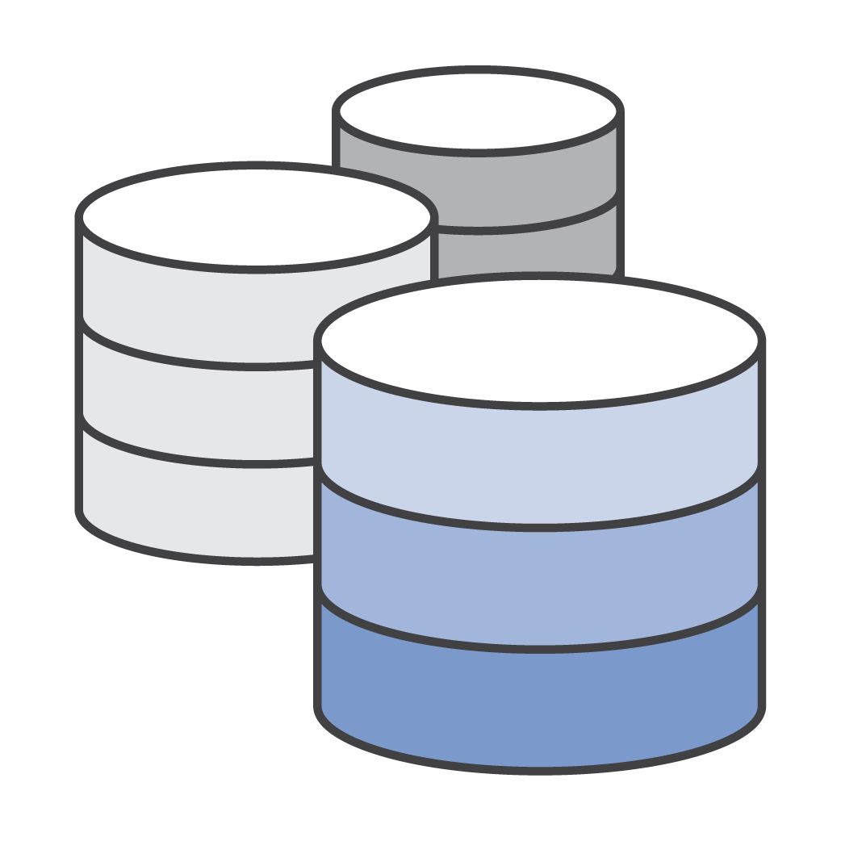
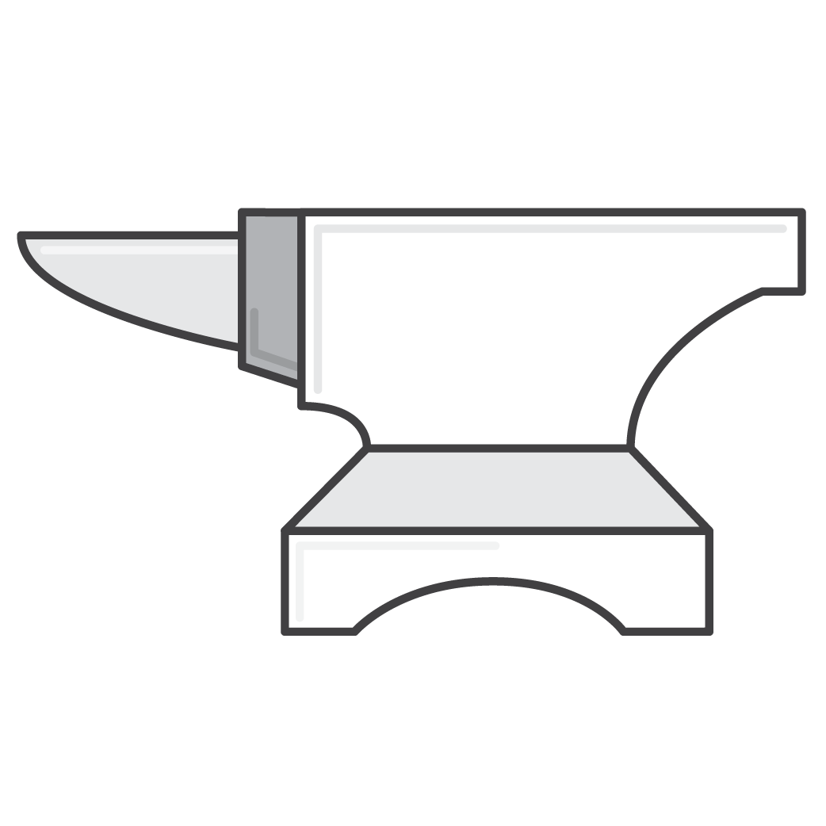


Amazon SageMaker: 10x better algorithms
Streaming datasets, for cheaper training
Train faster, in a single pass
Greater reliability on extremely large datasets
Choice of several ML algorithms
Notes:
The purpose of those algos is simply to be ten times better than whatever else is available today, that's the target we set for ourselves.
And you will see in some cases we hit and actually we do exceed that 10x improvement.
So, we have a few key principles here, it's important to understand them.
First of all those algos are streaming algos. So, typical machine learning algos will maybe load the whole data set in memory and then process it, which pretty much restricts how big your dataset can be or they're going to load from this; This can fill memory and is not the fastest and most efficient way to train; so we use streaming algos. And we'll see what benefits this brings
We just generally want to train faster, we want to train in a single pass. Those algos will only see a data point once and change their internal state to reflect that. So, they don't need to see data again and again to learn from it.
This will yield really good reliability even if we have crazy big data sets, you could have terabytes, tens of terabytes, hundreds of terabytes, it doesn't really matter because again we're streaming data, we're not loading it.
And well we try to provide as much choice as possible when it comes to algorithms

Slide 8
Infinitely Scalable Algorithms
Notes:
So you know we try to put our money where our mouth is, and we call them infinitely scalable algorithms.
And this collection of algorithms that I will present has been implemented by Amazon and it's being used every day by Amazon and AWS internally you know for our own purposes.

Slide 9

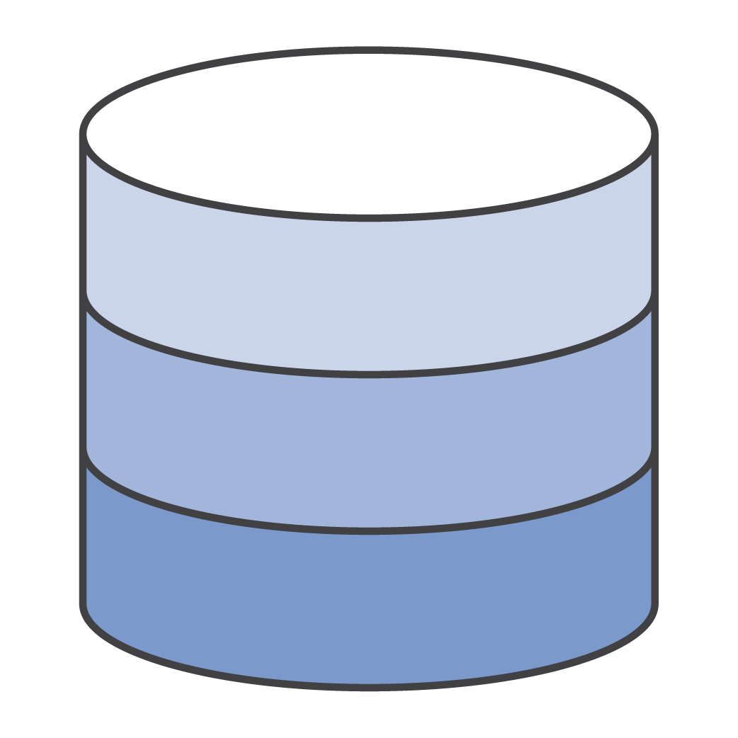

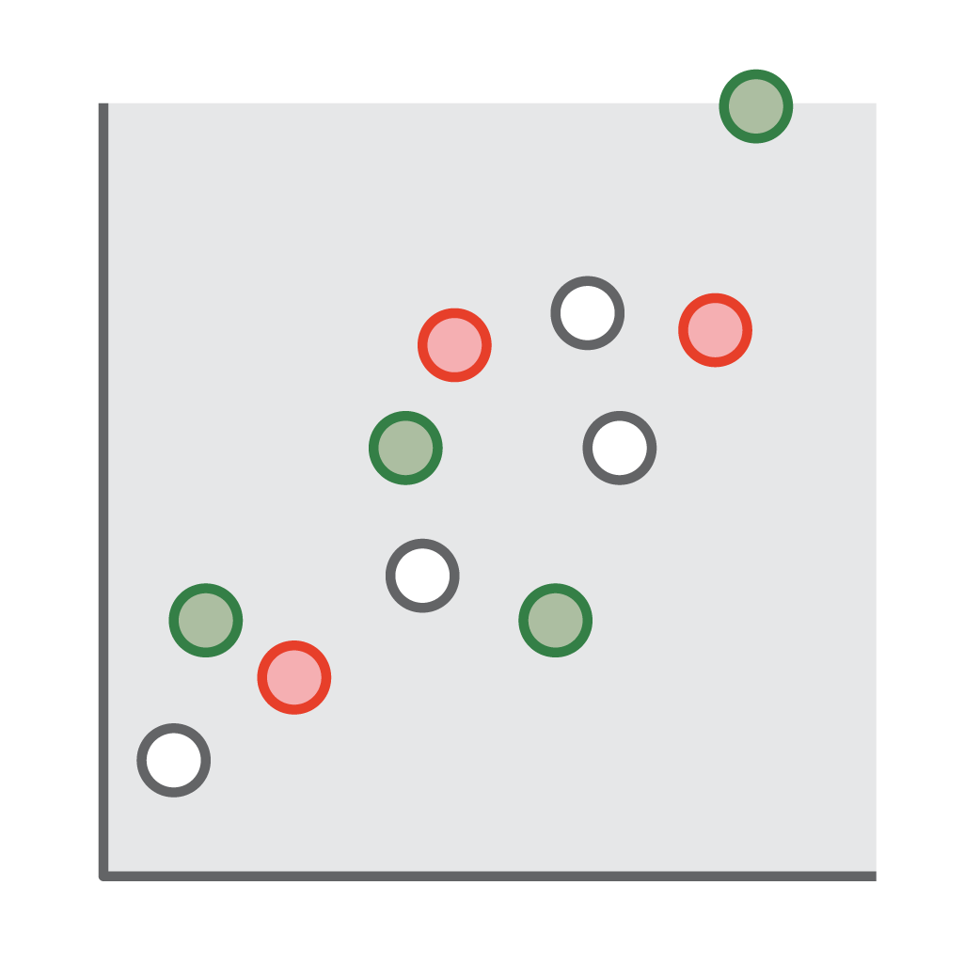


Streaming
GPU
State
Notes:
So, like I said, we’re streaming data to the algos. Every single data point in your data set will only be seen once by the algo and that's again the only way you could work with arbitrarily large data sets. There is no limit to the amount of data that this algorithm can support, can process because we’re streaming data through the algos, managing the state and building the model.

Slide 10
Streaming
Memory
Time/Cost
Data Size
Data Size
Notes:
So the benefit from that is memory consumption is now completely independent of the of the data set size because we don’t have to load stuff in memory before we can train on it. We can just stream the data through the algo and the algo learns as it goes.So, there is no limit again to the size.
When it comes to time and cost, it's going to be fully linear. The cost to train on 10 terabytes and the time to train on 10 terabytes will just be 10 times the cost and the time to train on 1 terabyte. So, even if you go to petabyte scale dataset, it will just go linearly and scale linearly. You will not experience any kind of degradation.

Slide 11
Distributed
GPU
State
GPU
State
GPU
State
Notes:
Obviously, when you talk about data sets this large, distributed training is important and these algo support that. So, we can actually split the data set across across multiple instances and, once again, this will be fully managed by SageMaker. Just fire them up and they do their job and then they terminate automatically. You don't have to manage them at all.
So, each instance is going to work on its own part of the data set, managing its own local state and then, we have a counter component that's going to actually make sure that the different local states are constantly updated into a shared state.
So we can do distributed training at scale and, again, there's no limit, probably to the amount of GPU or CPU instances you could fire up for a given job, giving you even more training speed for large datasets.

Slide 12
Shared State
GPU
Local
State
Shared
State
GPU
Local
State
GPU
Local
State

Slide 13
Cost vs. Time
$$$$
$$$
$$
$
Best Alternative
Amazon SageMaker
Minutes Hours Days Weeks Months
Notes:
And so, the results of this is you don't have to accept any trade-off.
Typically, you’re probably in a situation like that dotted blue line. You have to compromise between cost and training speed. If you want to train super fast you need to throw a lot of hardware at the problem, and that's probably cost more, way more. There's a premium to that speed-up and if you have a small budget then the only thing you can do is accept lower training times.
But with built-in algos and the performance, SageMaker really lowers the cost and it stays linear for a very long time right, almost flat as you can see. So, you can actually get extreme speed up with those built-in algos without your costs increasing like they would increase with other solutions.
The streaming nature of these algorithms, the fact that they support distributed training will let you just scale at flat cost unless you really really want very very low training times like minutes; Then yes, maybe it increases a bit, but moving from weeks to days is not going to require a significant increase of your training budget.

Slide 14
Linear Learner
Regression:
Estimate a real valued function
Binary classification:
Predict a 0/1 class

Slide 15
Linear Learner
More than 8x speed-up over naive parallel training!
Train
Fit thresholds
and select
Select model with best validation performance

Slide 16
Linear Learner
Regression (mean squared error)
SageMaker | Other
1.02 | 1.06
1.09 | 1.02
0.332 | 0.183
0.086 | 0.129
83.3 | 84.5
30 GB datasets for web-spam and web-url classification
Classification (F1 Score)
SageMaker | Other
0.980 | 0.981
0.870 | 0.930
0.997 | 0.997
0.978 | 0.964
0.914 | 0.859
0.470 | 0.472
0.903 | 0.908
0.508 | 0.508
Notes:
So, let's look at some examples. And we're going to take some time because I know these are pretty heavy slides.
So, here we tested Linear Learner on two datasets (a URL dataset and a spam dataset). What you need to compare here is the green line versus the purple line. And as you can see, there is a huge cost reduction when you train with SageMaker. It's pretty fast and you never actually end up training for a long time. And if you compare the orange one with the light blue one it's pretty much the same story. These are reasonably large datasets and and not only is SageMaker faster, it's significantly cheaper as well. So, you win on both counts which is not typical because usually, we always knew that there was this trade-off between time and costs. So, one or the other, but actually here we can get both and that’s not typical.
If we look at accuracy because you know SageMaker would not mean anything if it was inexpensive and fast but imprecise.
If we look at a regression model for linear regression, we can see actually we're comparable to two other implementations even though we stream data.
And when we run a classification task, again, we're doing quite okay, we’re pretty close to and even exceed the accuracy of a reference implementation.
So, this example here, in a nutshell, suggests you will train five, at least five times faster, if we compare that rightmost purple points to the rightmost green point. It’s, let's say, six seven minutes on SageMaker and maybe twenty seven minutes with the other technology and cost is two to three times lower as well, so very efficient.

Slide 17

Boosted Decision Trees
Throughput vs. Number of Machines
XGBoost is one of the most commonly used classifiers.
https://github.com/dmlc/xgboost
Notes:
This is the one that everybody uses I guess. XGBoost, it's probably the most common classifier out there to do binary classification or multi-class classification.
It's an open source project, so we just took that, tweaked it a bit and and now it’s available as a built-in algo on AWS.
As you can see here, once again, we see almost linear scaling when it comes to a number of machines versus throughput. So, if you just want to go twice faster and you had twice the number of machines, you'll be pretty close to linear scalability.
Super popular algo, sure some people are using this.

Slide 18
K-Means Clustering
Notes:
Let's move on to another algo, this one is the k-means clustering algo. So, it's unsupervised learning, just pass a lot of data points and ask the algo to cluster them, to group them into a number of clusters.

Slide 19
K-Means Clustering
Method | Accurate? | Passes | Efficient tuning | Comments
Lloyds [1] | Yes* | 5–10 | No
K-Means ++ [2] | Yes | k+5 to k+10 | No | scikit-learn
K-Means|| [3] | Yes | 7–12 | No | spark.ml
Online [4] | No | 1 | No
Streaming [5,6] | No | 1 | No | Impractical
Webscale [7] | No | 1 | No | Spark streaming
Coresets [8] | No | 1 | Yes | Impractical
Amazon SageMaker | Yes | 1 | Yes
[1] Lloyd, IEEE TIT, 1982
[2] Arthur et. al. ACM-SIAM, 2007
[3] Bahmani et. al., VLDB, 2012
[4] Liberty et. al., 2015
[5] Shindler et. al, NIPS, 2011
[6] Guha et. al, IEEE Trans. Knowl. Data Eng. 2003
[7] Sculley, WWW, 2010
[8] Feldman et. al.

Slide 20
K-Means Clustering
Running Time vs. Number of Clusters
 | k | SageMaker | Other
Text 1.2GB | 10 | 1.18E3 | 1.18E3
 | 100 | 1.00E3 | 9.77E2
 | 500 | 9.18.E2 | 9.03E2
Images 9GB | 10 | 3.29E2 | 3.28E2
 | 100 | 2.72E2 | 2.71E2
 | 500 | 2.17E2 | Failed
Videos 27GB | 10 | 2.19E2 | 2.18E2
 | 100 | 2.03E2 | 2.02E2
 | 500 | 1.86E2 | 1.85E2
Advertising 127GB | 10 | 1.72E7 | Failed
 | 100 | 1.30E7 | Failed
 | 500 | 1.03E7 | Failed
Synthetic 1100GB | 10 | 3.81E7 | Failed
 | 100 | 3.51E7 | Failed
 | 500 | 2.81E7 | Failed
~10x Faster!
Notes:
So, here once again, we compared this implementation to the best implementation we could find out there and, as you can see, the billable time in minutes, so the actual cost and time again which is the same thing for us, because you pay for this by seconds.
So, time and cost are strictly equivalent for SageMaker. We see that there is a huge cost reduction for the building, for the training of those clusters.
And we see some good scalability as well because when we move from 10 clusters to 500 clusters, there's a bit of a bump but nothing like the other one.
And when it comes to precision, the numbers that you see here are the actual, the total sum of squared distances between the points and their respective center (which is how clustering works) and we can see that for pretty much every configuration, we are either really close or we even exceed that best implementation, and more interestingly, when we move to very large datasets, like the two lower ones for advertising and the synthetic one, when we move to big data sets, the other solution drops out. And SageMaker just goes on and it would go on forever because again we're streaming data so it doesn't matter how large the data set is.

Slide 21
Principal Component Analysis (PCA)
Notes:
Here's another one. It's The Godfather of machine learning. It's called PCA and PCA is used to reduce dimensionality.
Let's say you have a thousand features in your dataset and that's way too much and you want to automatically reduce that to 50, 10, whatever number of features is really needed for your model, removing correlation etc. That's what PCA does.

Slide 22
Principal Component Analysis (PCA)
Cost vs. Time
Throughput and Scalability
More than 10x faster
at a fraction the cost!
Notes:
So, here, again we tested it. There are two modes: deterministic and randomized but never mind. And this is very spectacular, the speed-up and the cost is just insanely lower using our own implementation compared to the best implementation you're looking at here, the blue one.
And when you look at throughput and scalability, you can see that, as we add machines, for the green and orange bars, as we add machines, we keep, we maintain the same level of throughput. So, more hardware maintains the same throughput, the same amount of data we can process with PCA.
So, if you want to go faster, just add more machines, it will go faster and scale linearly.

Slide 23
Factorization Machines
 | Log_loss | F1 Score | Seconds
SageMaker | 0.494 | 0.277 | 820
Other (10 Iter) | 0.516 | 0.190 | 650
Other (20 Iter) | 0.507 | 0.254 | 1300
Other (50 Iter) | 0.481 | 0.313 | 3250
Click Prediction 1 TB advertising dataset,
m4.4xlarge machines, perfect scaling.
50
40
30
machines
20
machines
10
machines
Notes:
Here's another one factorization machine which is a generalization of linear regression and don't be scared by the equations here.
So factorization machines are popular for recommendation, building recommendation engines and I'll show you a demo in a few minutes.
So here, we trained on one terabyte of advertising data, trying to do click prediction. And that's not an easy problem, it's a one of the hardest problems. And we tested it on ten machines, 20 machines, all the way to 50 machines.
And you can see the cost is almost completely flat. And you have pretty much linear scaling as well. It takes almost eight minutes on ten machines, takes about four minutes on 20 machines, it takes two minutes on 40 machines. So, as you double hardware you divide by 2 your training time.
Flat cost and
Perfectly linear scaling
If we look at precision again, if you look at loss and the F1 score, which is a measure of how well our classifier is doing, what we can see there, again, very close or even better than reference implementations who would train for much much longer. So, in very little time, we actually get to almost state-of-the-art results.

Slide 24
Random Cut Forest

Slide 25
DeepAR: Time Series Forecasting
 |  | Mean absolute percentage error |  | P90 Loss
 |  | DeepAR | R | DeepAR | R
traffic Hourly occupancy rate of 963 Bay Area freeways |  | 0.14 | 0.27 | 0.13 | 0.24
electricity Electricity use of 370 homes over time |  | 0.07 | 0.11 | 0.08 | 0.09
pageviews Page view hits of websites | 10k | 0.32 | 0.32 | 0.44 | 0.31
 | 180k | 0.32 | 0.34 | 0.29 | NA
Network
Input
One hour on p2.xlarge, $1
Notes:
This is one of the newest ones called DeepAR and you can work with time series.
A time series is a popular use case, so here we tried it on traffic data, electricity data, website traffic etc and we compared it to the best implementation we could find out there, which is using the R language.
As you can see, we tend to beat pretty much all the time the reference implementation, just delivering lower percentage error and lower loss. So, this is a super, not only a super accurate algo, it's a super scalable algo.
That's what you want, you want something scalable, something unexpensive and something accurate. And we always knew remember that Iron Triangle costs quality and budget pick. It's the number-one rule in project management, you can't have all three. Well, somebody worked some magic because here for those algos we seem to be getting all three we maintain quality while cutting significantly training times and thus the spent associated so it's a bit of a magic service.

Slide 26

Image Classification
Linear Speedup with Horizontal Scaling
ResNet implementation with Apache MXNet.
More networks to come.
Transfer learning: begin with a model already trained on ImageNet!
Notes:
Image classification classification is pretty much what you could do with Amazon Rekognition except if you need to classify very domain specific images like medical images, car parts images, whatever just specific things, it's fair to say Rekognition is not going to do a very good job at that because it's been only trained on general data.
So, here, we bring you a built-in algo, it's based on the ResNet architecture, so ResNet is the state of the art image classification deep learning model, so what you do here, you can just grab that container and select a model and get to work. You don't have to actually design anything just like in the other cases and, when we look at performance, once again, we see almost linear scaling, which is very desirable if you want to train on a huge dataset.

Slide 27
BlazingText – Word2Vec

Slide 28
Neural Topic Modeling
Perplexity vs. Number of Topic
(~200K documents, ~100K vocabulary)
Output term counts vector
Decoder:
Softmax
Sampled Document
Representation
Document
Posterior
Encoder: feedforward net
Input term counts vector
Notes:
Another one, this one is the neural topic modelling. It’s a popular way, it's a popular algo for Natural Language Processing, and you could build topics with it like comprehend does.
And here again we tried it against the best implementation we could find and it gets to significantly lower perplexity. Perplexity is the quality measure you use when you're working with a natural language processing, when you do translations or you build topics. So we get 20% better perplexity which is a very significant performance improvement.

Slide 29
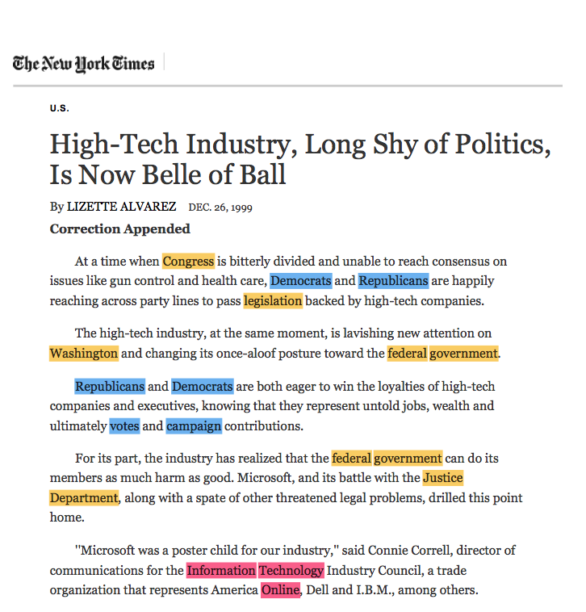
Spectral LDA
Training Time vs. Number of Topics
Notes:
LDA is another topic modeling algo.
So, here, once again, you have to compare the orange one with the light blue one and you see on the number of topics, that training time is much much lower than the reference implementation. And you see it's fair to say that the scalability is is quite linear. But, you know there's obviously much more work involved in building hundred topics than twenty. So, it's more costly but it scales pretty well.
And then, if you compare the green one to the purple one, it's about the same thing. So, the training time is just so much lower. Look at the scale over there, each square is 50 minutes, so we literally save hours on each job.

Slide 30
Sequence to Sequence
English-German Translation
Based on Sockeye and Apache MXNet.
Multi-GPU.
Can be used for Neural Machine Translation.
Supports both RNN/CNN as encoder/decoder
Best known result!
Notes:
Another one is called sequence to sequence. It's a Natural Language Processing algo and we use it for neural machine translation. Actually, last year we published an open source project called Sockeye and the Sockeye lets you train translation models.
So, once again, if if you wanted to translate Hebrew to Russian which is not available inside of Amazon translate for now, well you could probably try to build a model using sequence to sequence on Amazon SageMaker; Or you could go and grab the Sockeye open source project if you didn't want to use an AWS service, and you could run Sockeye even on your own machines and train your model. Okay, so this is based on Sockeye and Amazon Translate is also based on this. So, many options to get to the same result.
So, as you can see, it's pretty good when it comes to measuring translation quality; Researchers use the bleu score, which is a quality metric. Obviously we get reasonably quickly to the state-of-the-art result and, in some cases, it's fair to say we slightly exceed it.
Okay I don't want to brag

Slide 31
Amazon SageMaker built-in algorithms
 | Algorithms | Description
Tabular Classification & Regression | Linear Learner XGBoost K-nearest neighbors Factorization Machines | Supervised algorithms used for regression and classification problems on tabular data
Computer Vision | Image classification Object detection Semantic segmentation | Deep neural network supervised algorithms for analyzing images, such as detecting an object in an image
Text Processing | BlazingText (word2vec) Neural topic modeling Latent Dirichlet allocation (LDA) Sequence 2 sequence Object2vec | Supervised and unsupervised algorithms to generate embeddings, extract topics, or do translation on text data

Slide 32
Amazon SageMaker built-in algorithms
 | Algorithms | Description
Anomaly Detection | Random cut forest IP Insights | Unsupervised algorithms for detecting anomalous points
Forecasting | DeepAR Forecasting | Time-series forecasting algorithms for predicting future quantities based on historical data
Clustering | K-means clustering | Unsupervised techniques for identifying groups of points that are “close” to each other
Dimensionality Reduction | Principal components analysis (PCA) | Unsupervised technique used in feature engineering to reduce the number of feature columns

Slide 33
You learned - Each algorithm solves a type of prediction problem
Computer Vision
Topic Modeling
Classification
Linear Learner *
XGBoost
KNN
Factorization Machines
Image Classification <>
LDA
NTM
Object Detection <>
Semantic Segmentation
Recommendation
Forecasting
Factorization Machines * (+ KNN)
DeepAR *
Working with Text
Blazing Text
Supervised
Unsupervised *
Clustering
Anomaly Detection
Random Cut Forests *
Kmeans *
KNN
IP Insights *
Feature Reduction
Sequence Translation
Regression
Linear Learner
XGBoost
KNN
PCA
Seq2Seq *
Object2Vec
* = distributed training
<> = incremental training

Slide 34
Thank You

